Slide 1
Nicolaus Copernicus
Astro Chapter 3-2

Slide 2
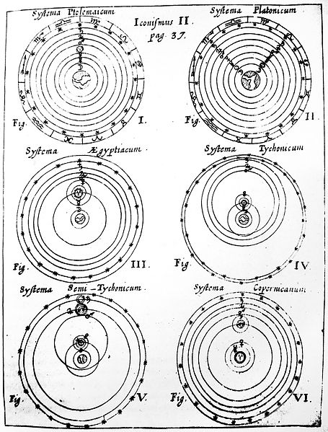
For nearly 2000 years, civilization and astronomy was dominated by the Aristotle and Ptolemaic model of the universe.

Slide 3
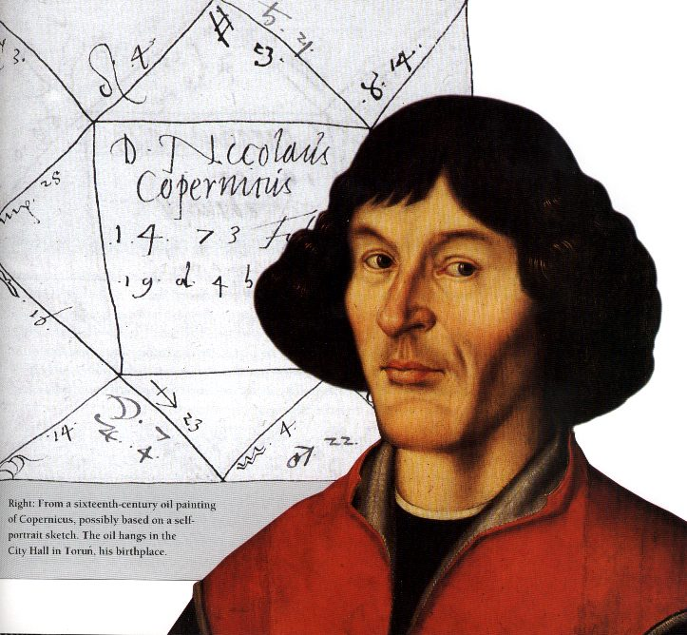
Those views began to change with Nicolaus Copernicus’ model.

Slide 4
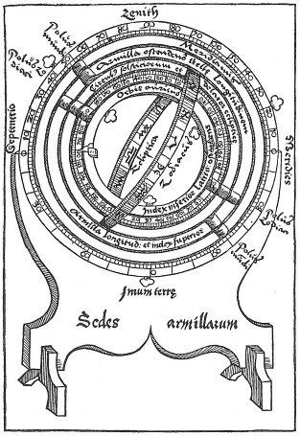
He was raised in the Roman Catholic Church, and feared persecution and heresy.
He was interested in
astronomy and
science from a
young age.

Slide 5
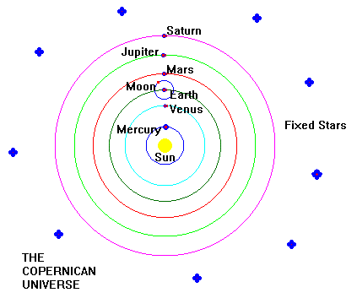
Astronomy of the time was based on Ptolemy’s model of Aristotle’s universe.
The Copernican model was heliocentric → sun centered.

Slide 6
In his book On the Revolutions of Celestial Spheres, published after his death in 1543, Copernicus outlined his argument that the sun, not the Earth was the center of the universe.

Slide 7
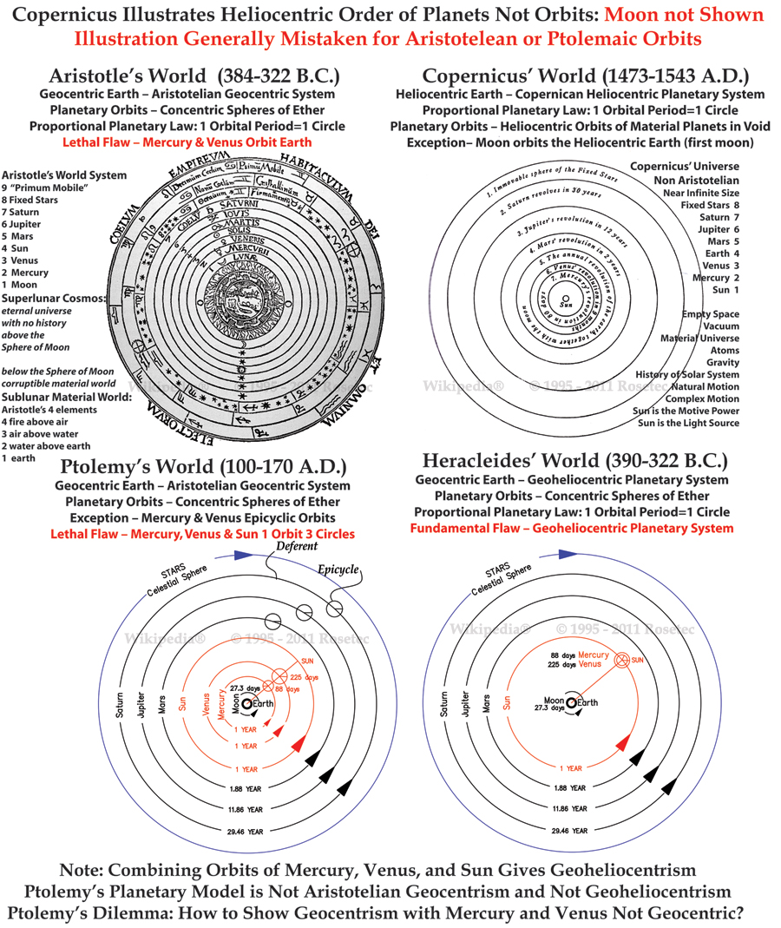

Slide 8
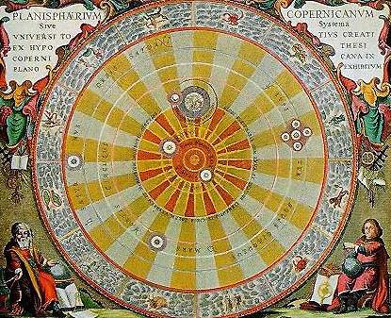
His model explained the retrograde motion of some planets from Earth’s perspective. This was because the Earth orbits the sun faster than some planets and slower than others.

Slide 9
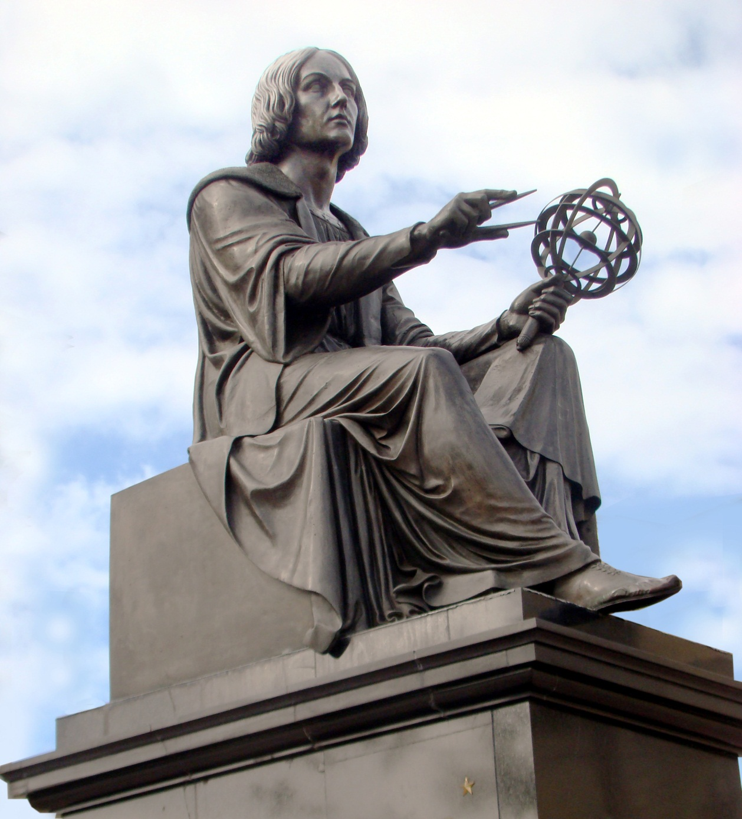
Copernicus still believed in the theory of uniform circular motion, like Aristotle, even though he recognized it did not precisely describe planetary motion.

Slide 10
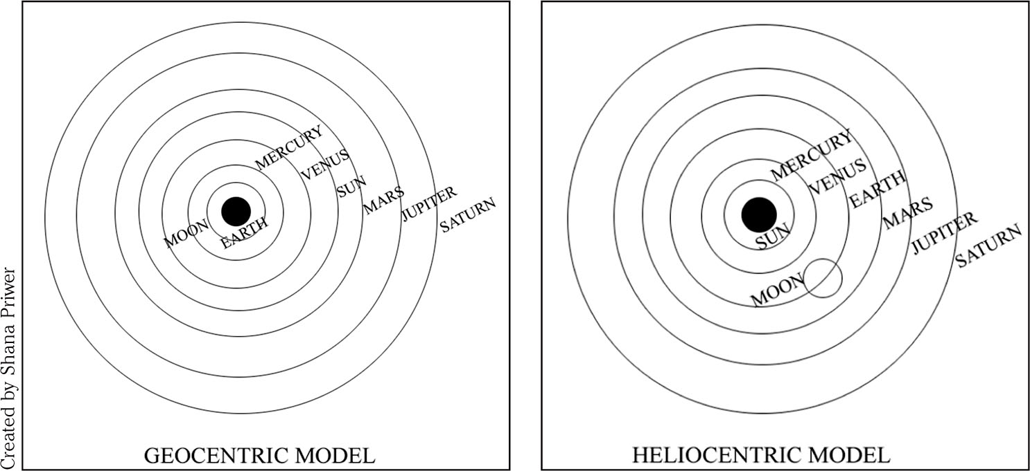
Never-the-less, Copernicus hypothesis that the “universe” (known at the time) was heliocentric was correct.
Even though it was different from what we now know to be correct.

Slide 11
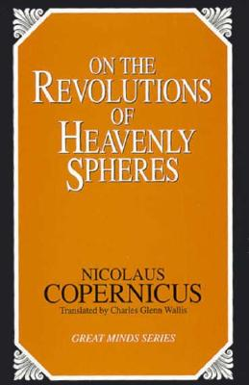
The Copernican Revolution was a gradual recognition that the Earth was not the center of the universe.
It changed the
paradigm
scientists used.
Paradigm – a set of
scientific ideas
and assumptions

Slide 12
This “revolution” has helped change our views of our place in the universe, by making us not necessarily the most important part of it, and helping humanity realize that we are a part of the universe, but not the biggest part.

